Slide 1
Network-wide anomaly detection based on Pca Data mining Final Project University of Missouri 2014 May 7
Longhai
Ronny
Mary
Carrie

Slide 2
Outline
Introduction - Network measurement anomaly detection
Problem – Path level vs. Network-wide level anomalies
Approach – Principle Component Analysis
Results & Evaluation
Conclusion & Demo

Slide 3
1.Introduction
Network performance monitoring
Different measurement data, e.g. one-way delay and TCP throughput captured by monitoring tools like PerfSONAR
Network anomaly detection
Different algorithms such as APD and Q-Statistics
Helps the network administrators to diagnose the bottlenecks in complex networks.

Slide 4
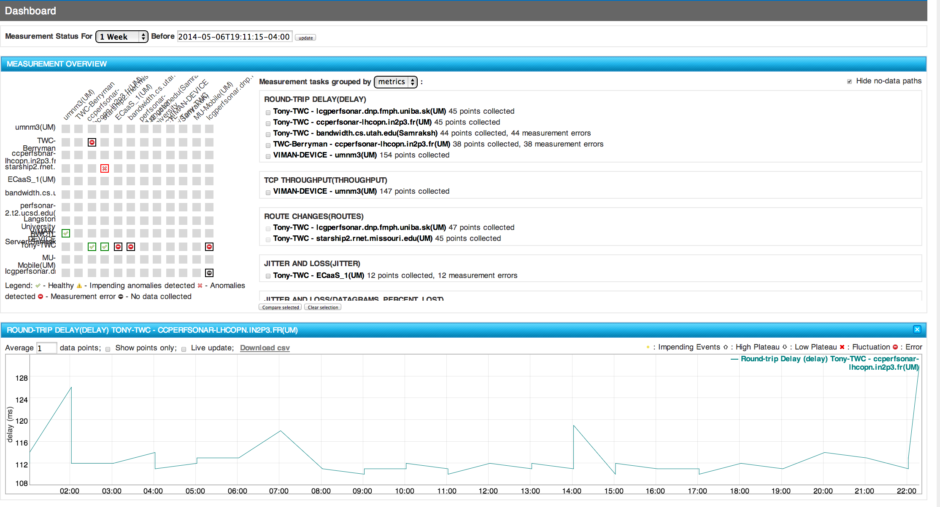
Network monitoring

Slide 5
2.Problem
Current anomaly detection algorithms are designed to detect path level anomalies
Given the complex scalable network, it costs too much time to perform the algorithm for millions of paths.
How can we detect network-wide level correlated anomalies with minimum calculation and computing time

Slide 6
Correlated and uncorrelated anomalies
Correlated anomalies – all the traces have anomalies at the same time point
Uncorrelated anomalies – each trace has anomalies at different time point
A
If an anomaly is occurred at the source
Correlated anomaly
B
C
D
E
F
A
If an anomaly is occurred at the destination
Uncorrelated anomaly
B
C
D
E
F

Slide 7

Topology - network wide correlated anomaly
E1
E2
E3
DOMAIN A
R1
measurements would
reflect anomaly events on link R1<->R2
DOMAIN B
R2
E4
E5
E6
First eigen-vector for common anomalies (maximum variability)
Detect Accurately anomalies events

Slide 8
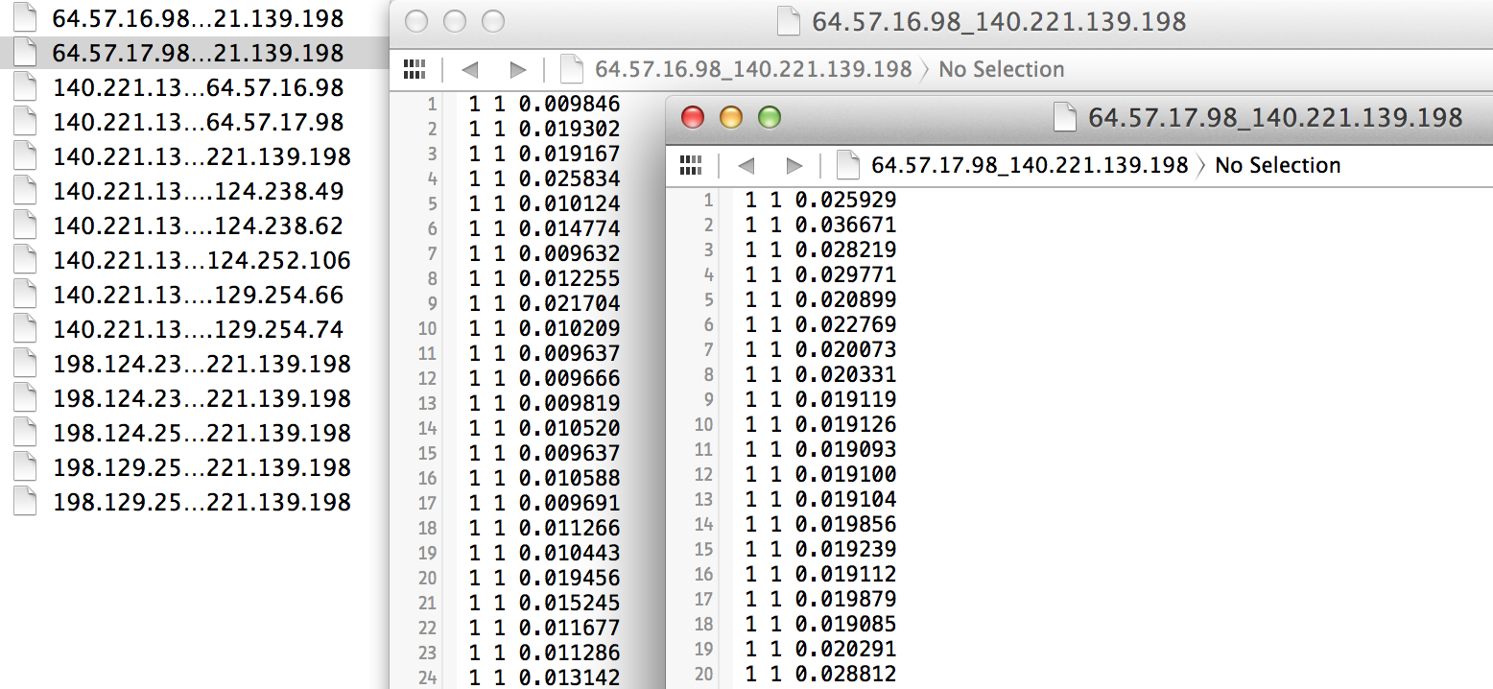
Dataset
One way delay measurement from 15 different paths
Each path has 10,000+ measurement data

Slide 9
Dataset
From the measurement archive we know there are
5 Correlated anomaly – all the traces have near time points 3000 4000 5000 6000 7000.
10 Uncorrelated anomaly – Different single traces have at certain time points.
Notes:
We are trying to use PCA/APD approach to check if we can detect all the correlated and uncorrelated anomalies. Now Mary will talk about the APD anomaly detect algorithm.

Slide 10
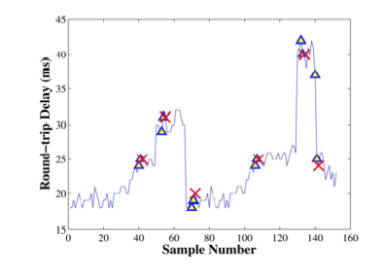
3. Approach – APD/PCA
APD Algorithm Basic Idea

Slide 11
APD Algorithm
In the APD(Adaptive Plateau Detector) algorithm additional parameters “trigger duration” and “sensitivity” are used
The trigger duration and sensitivity are used to
update the threshold depending on the curve, resulting in a dynamically changing threshold for anomaly detection
Plateaus are detected when the cross a defined threshold and stay there for the defined trigger duration before returning back under the threshold.

Slide 12
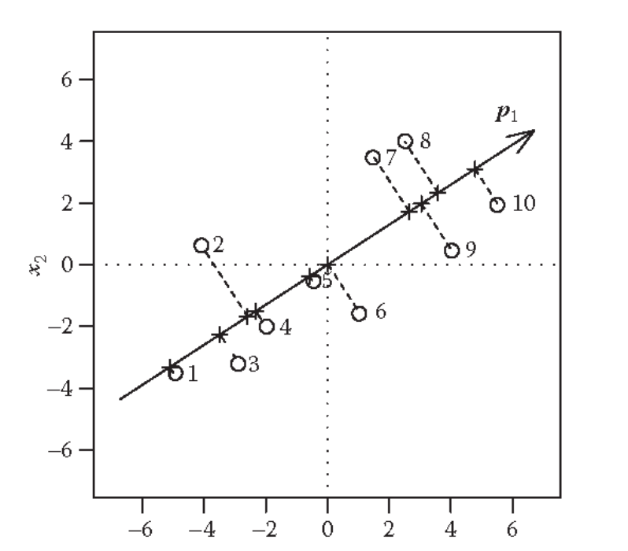
Background on PCA
PCA(Principle Component Analysis) is a coordinate transformation method that maps a given set of data points onto new axes. These axes are called the principal axes or principal components.
The principal axes are ordered by the amount of data variance that they capture. The first principal component captures the variance of the data to greatest degree possible on a single axis.

Slide 13
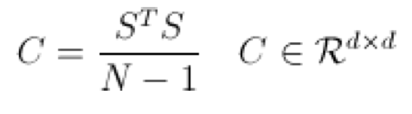

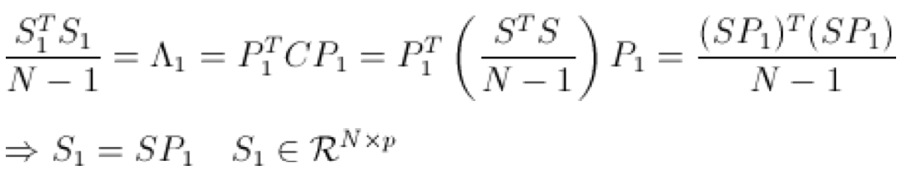
PCA steps
1. Centralization sum(Xi)=0
S = X - repmat( mean(X,1) , size(X,1) , 1 );
2. Calculate the covariance matrix
X
3. Eigen decomposition & choose the first k vectors with high Eigen values
X = X – repmat
4. Project the P to original matrix

Slide 14
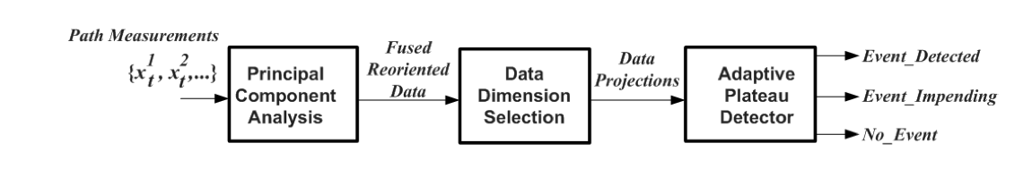
Workflow

Slide 15
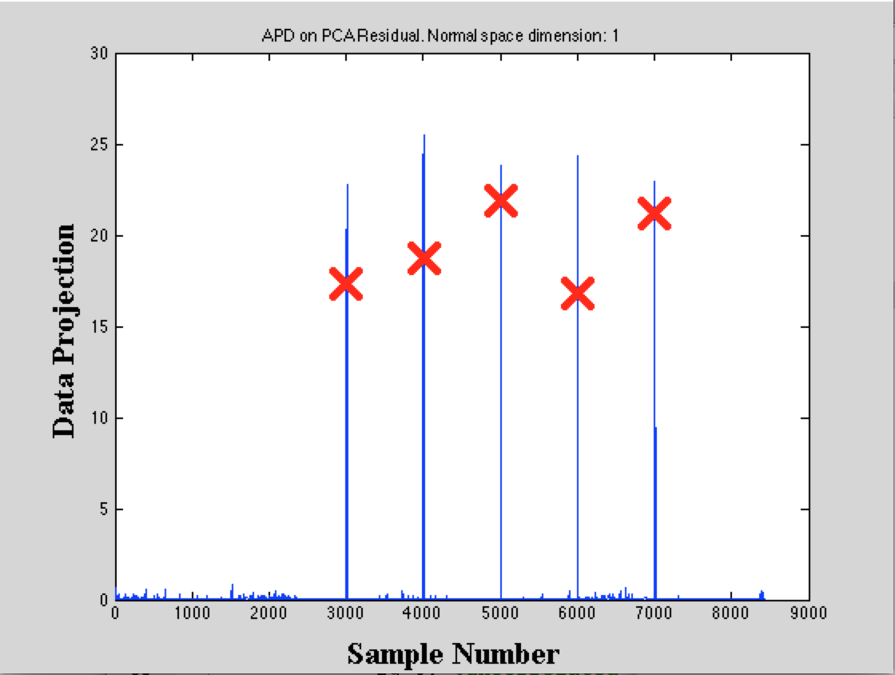
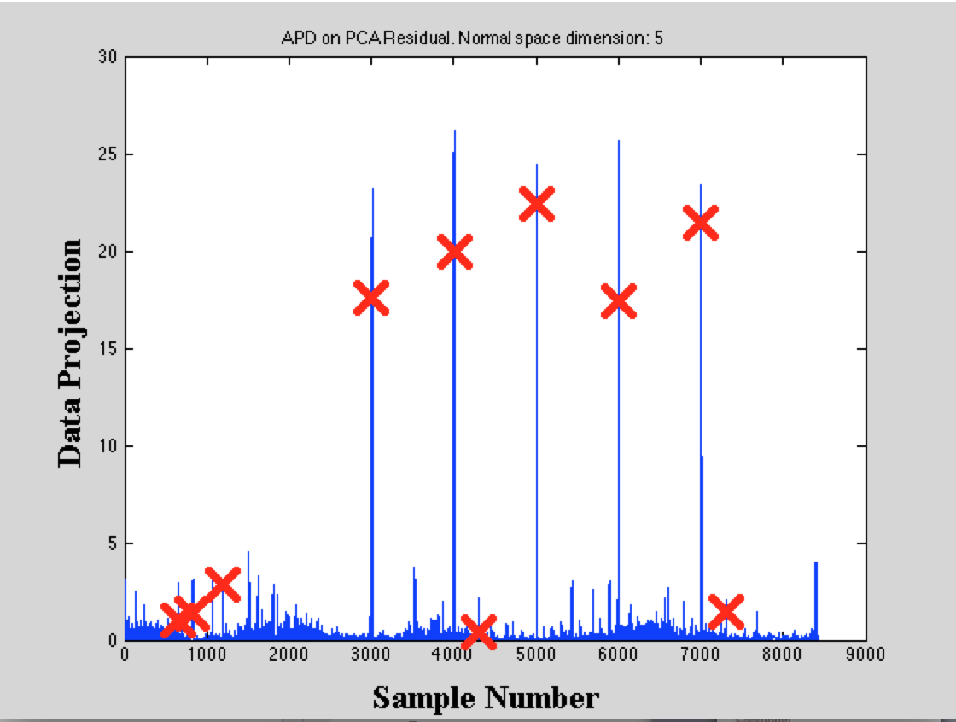
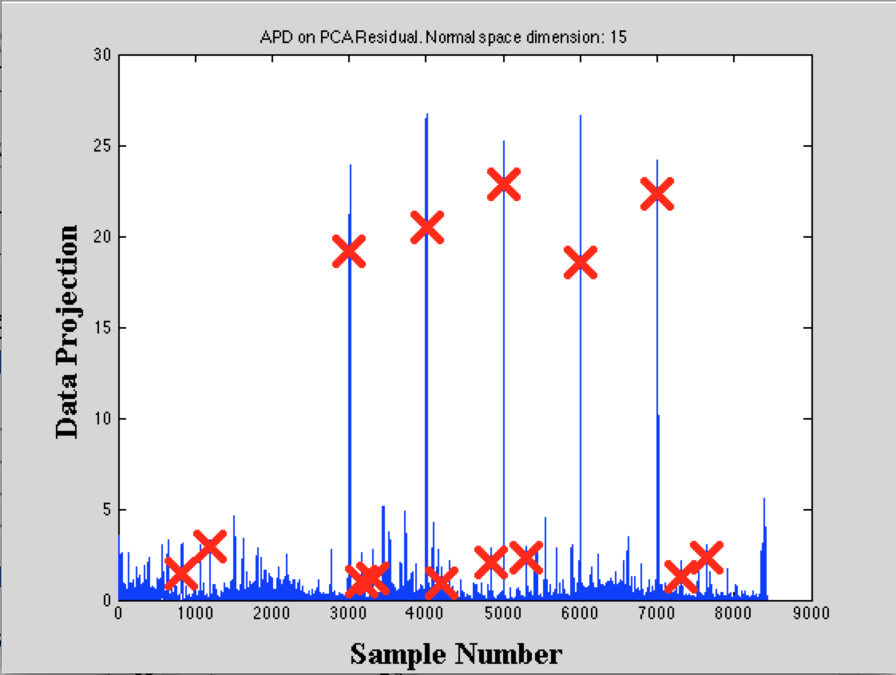
4.Results
Captures all the correlated anomalies in APD scheme

Slide 16
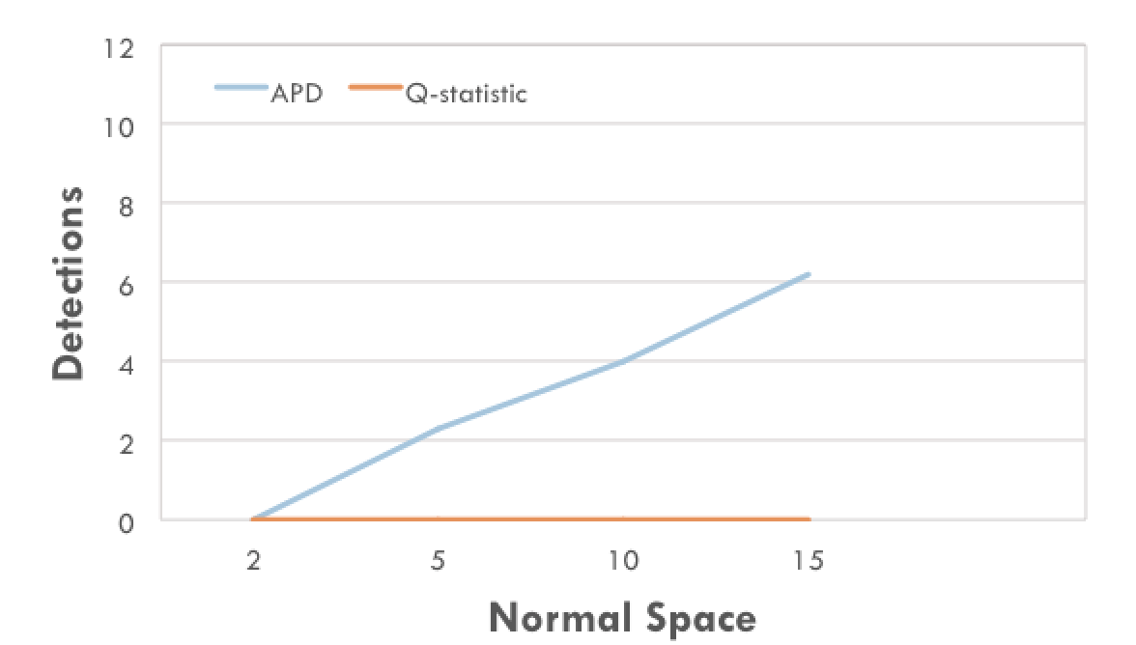
4.Results
More number of principle components, captures more uncorrelated anomalies.

Slide 17
5.Conclusion
We use the PCA&APD skim to diagnose the network-wide correlated anomalies.
The PCA is used to capture the principle components from huge amount measurement data sets and project the original matrix into one dimension.
We can significantly reduce the computational complexity of detecting traffic spikes while capturing all the correlated anomalies.
With increasing number of principle components, we can get more uncorrelated anomalies in the cost of computing time.

Slide 18
Thank you!

